Slide 1
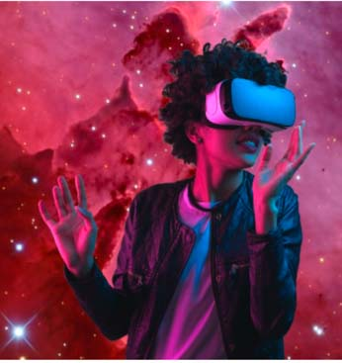
Amazing Races Spanning from Outdoor Instruction all the way to Virtual Reality
By: Felicia A. Smith, MLIS
Stanford University
http://library.stanford.edu/people/felicias

Slide 2
flipped classrooms
Replaces rote, point & click demonstrations.
Saves valuable class time for more meaningful search syntax strategies & critical evaluation skills.
Image @ https://web.usd475.org/depts/it/etc/SitePages/Flipped%20Classroom.aspx

Slide 3
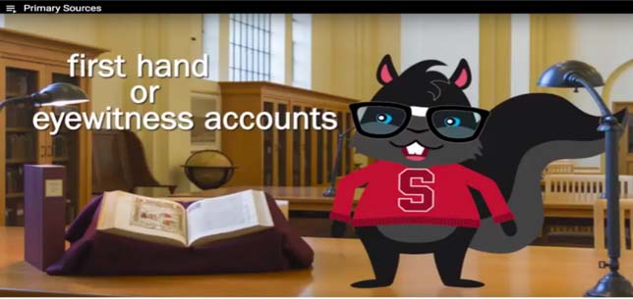
Nerd Squirrel Videos
Point of Need &
Just in Time
Reduced the amount of time, librarians spend in workshops demonstrating the point & click
https://youtu.be/0UX0LWyV6G4

Slide 4
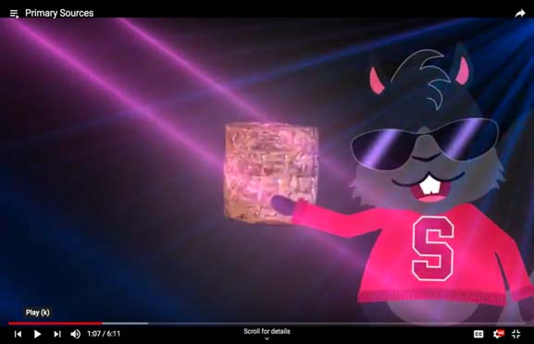
Nerd Squirrel Videos
Storyboard
Narrator
Gender Neutral
Name it
“Porky-Pigging it”
Stickers
Cost & Updates
Evaluation

Slide 5
Storyboard

Slide 6
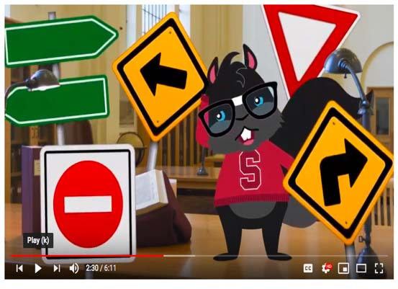
Nerd Squirrel
NEW PHONE WHO DIS?
Name it
Gender Reveal ??
“Porky-Pigging it”
Black squirrel as our library mascot. Prevalent on Stanford’s campus. Avoids heteronormative (gender) and racial identities issues.
People point out the “black” Nerd Squirrel is quote, “Porky-Pigging it” meaning only wearing a sweater.

Slide 7
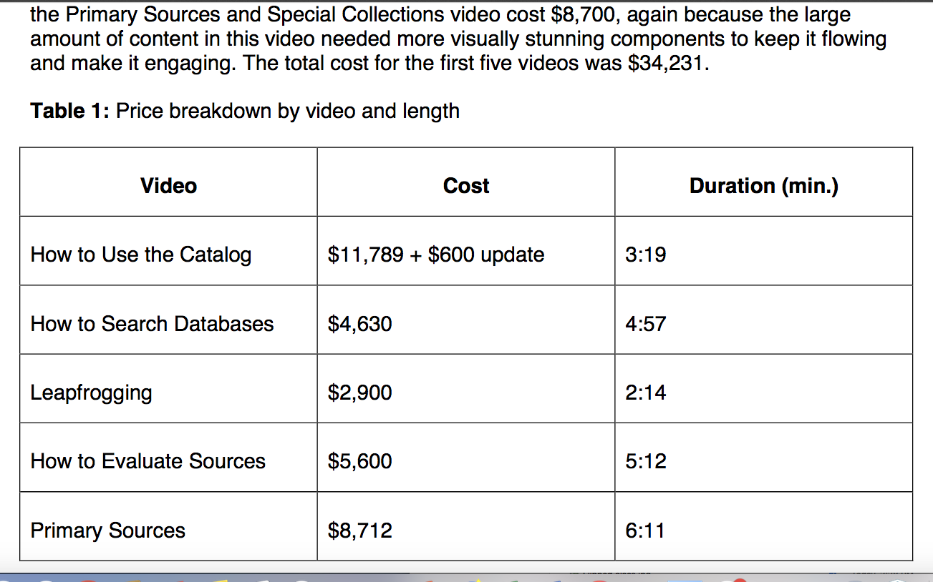
Video Pricing
Source:
Marchis, Bogdana. 2018. Putting Levity into Literacy: Professionally Produced Library Instruction Videos. Journal of Information Literacy, Vol. 12, No. 2, p. 113-120.

Slide 8
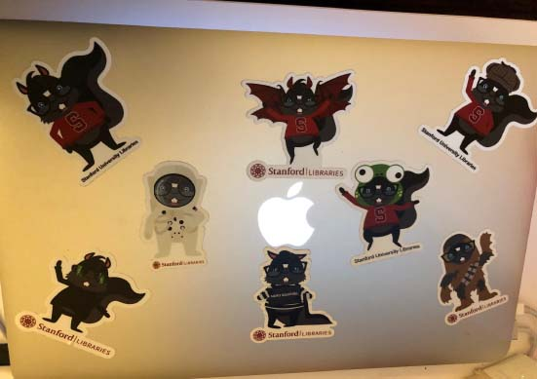
STICKERS
Great PROMOTION for videos, specifically and the libraries, generally.
Instructors Pre-Ordered
Students put on laptops
1,000 of the
3" x 3" die cut,
cost $600.

Slide 9
EVALUATIONS
Student Feedback:
“We love the Nerd Squirrel”
“I had planned to just skip ahead in the video but couldn’t because I got sucked in right from the beginning!”

Slide 10
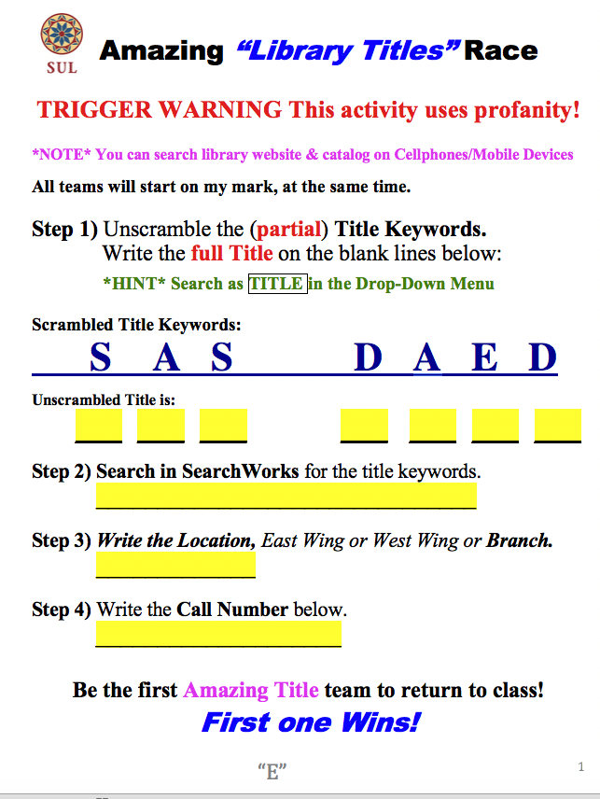
Title: “Ass is Dead! Long Live the Ass!”

Slide 11
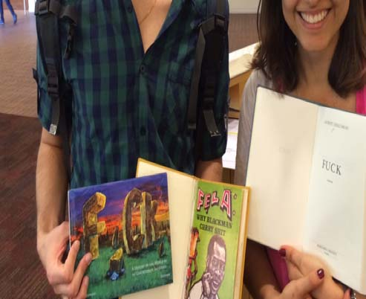
Sample Title: “FUCK! History of the World in 65 Unfortunate Incidents”

Slide 12
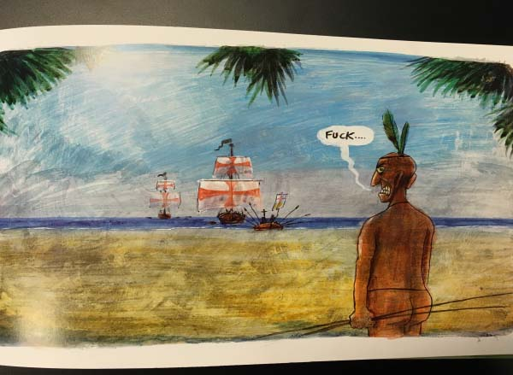
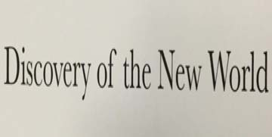
Sample WINNER: “FUCK! History of the World in 65 Unfortunate Incidents”

Slide 13
Outdoor classes
Students use their mobile devices outside. Being untethered allows me the freedom to teach anywhere, physically. Nevertheless, I still aspire, to teach anywhere, virtually!
Albert Einstein :
“I never teach my pupils, I only attempt to provide the conditions in which they can learn.”

Slide 14
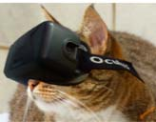
Why use VR ?
VR Technology replaces boring, antiquated lecture format
VR allows for real life situations instead of foreign jargon

Slide 15
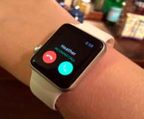
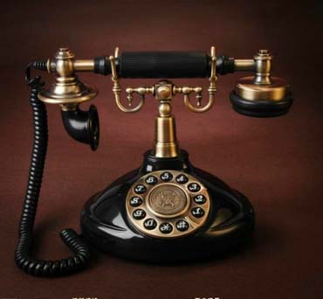
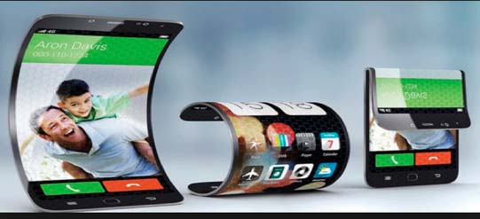
NOW & THEN
19th Century Image
2019 Images

Slide 16
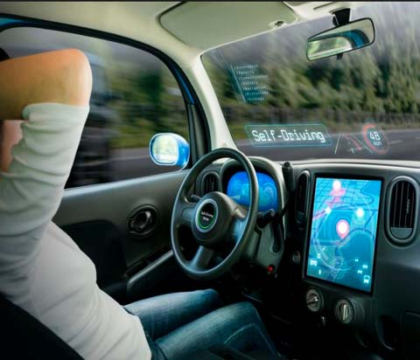
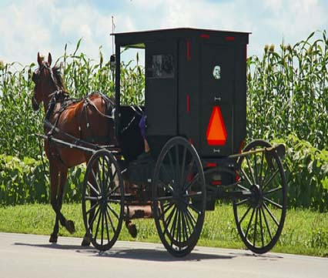
NOW & THEN
2019 Image
19th Century Image

Slide 17
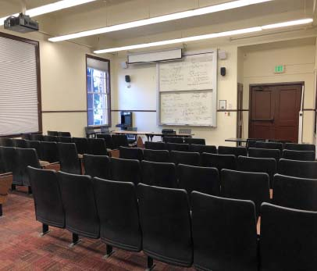
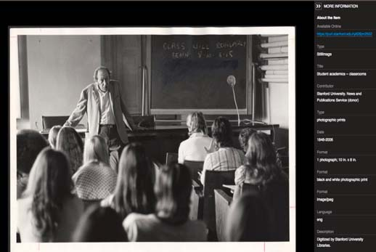
STANFORD Classroom
2019 Image
1800s Archival Image
purl.stanford.edu/ry626jm2552

Slide 18
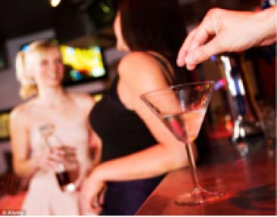
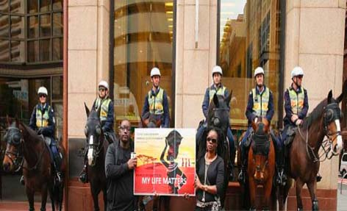
scenarios
Credibility: E.R. Nurse vs Nightclub Stranger
Fake News: Black Lives Matter Protesters vs Police Horse

Slide 19
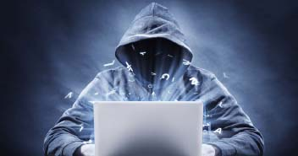
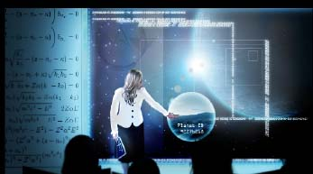
CREDIBILITY
#1
#2
1st choice between typical situations, in daily life.
2nd choice between library or academic sources.
Both requires them to use the exact same “common sense” reasoning.
STRANGERS
SCHOLARS

Slide 20
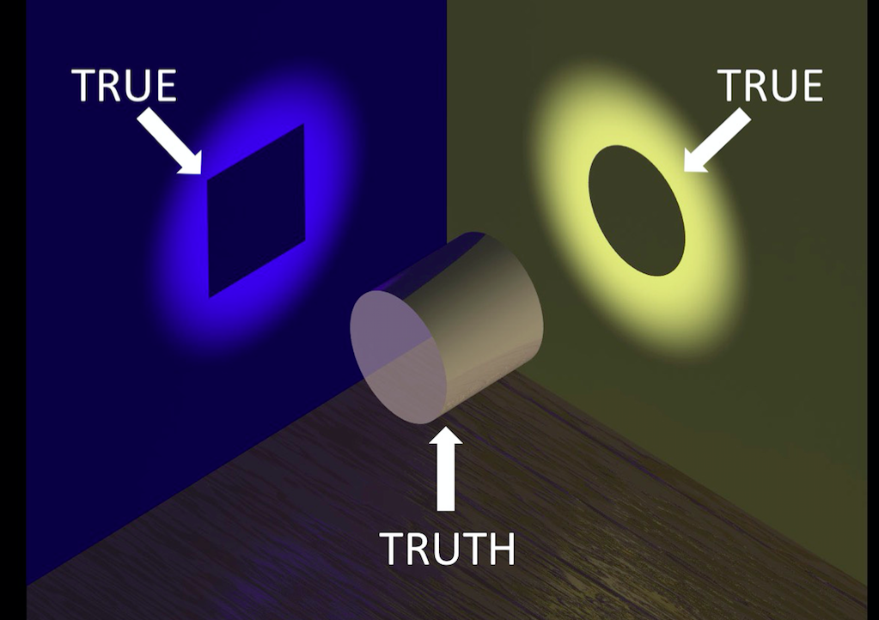
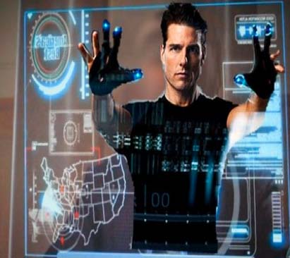
FAKE NEWS
https://www.snopes.com/fact-check/police-horse-kicks-blm-protester/

Slide 21
logistics
Art Style
Futuristic and high fidelity using bold colors for buttons to attract attention.
Staff Resources
1 artist - 60 hours.
1 designer - 60 hours.
1 producer - 60 hours.
Performance Specification
Executable Windows (exe) application, compatible with HTC Vive headset (SteamVR). Vive controllers for interaction. Alternatively, an executable iOS application, compatible with Google Cardboard and users’ cellphone.
Control & Setup
4x4 room-scale VR setup with HTC Vive.
HTC Vive controllers, users move virtual hands to grab objects or press buttons.
Utilizing room-scale VR capabilities of the HTC Vive.

Slide 22
COST
Timeframe of 6 months, based on conceptual design and prototyping specifications, below are estimated costs from several vendors:
Full Scope ($79,000). *Highest was Half a Million!
Signature Fee = $18,000.
$15,000 Game Design Document (Project Management & Art).
$15,000 First Playable customizable characters.
$31,000 final installment.
Medium Scope ($54,000)
Simplified less realistic art.
Instead of animated robots, feature square machines with blinking lights.
Minimal Scope ($44,000)
Smallest scope focusing on the core intent.
Replace robots with conductor voice and subtitles.
Simplified scenery and effects.

Slide 23
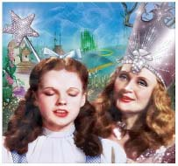
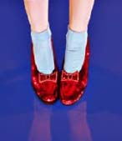
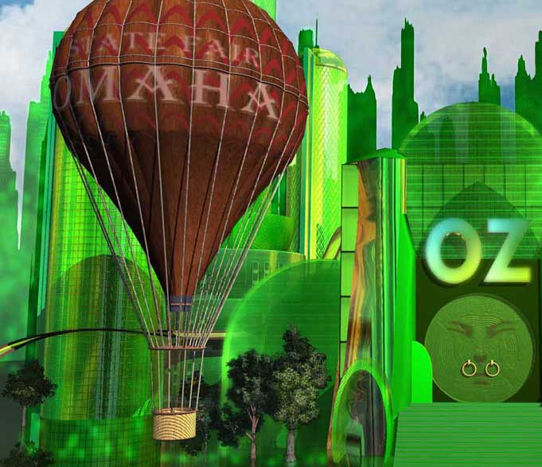
Wizard of oz analogy
Dorothy represents patrons.
Glinda the Good Witch represents librarians, naturally.
Hot air balloon represents traditional lecture workshops.
Ruby slippers represent the "common sense"
that the patrons have had all along.

Slide 24
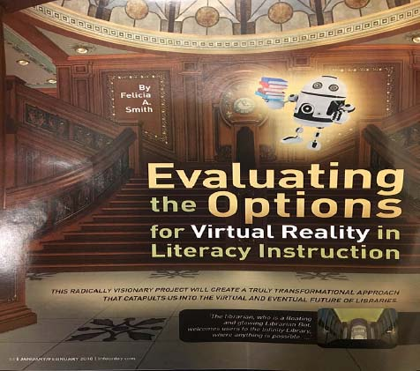
More details in my article
“Common-Sense” Scenarios can show students
they already possess and use critical evaluation skills.
http://www.infotoday.com/cilmag/jan18/index.shtml

Slide 25
IN CLOSING
This LOEX Program Track asked us to share ways that we
“Lead & Innovate & Blaze New Trails.”
I have shared a few of my bold efforts to flip my classes, including:
PROFESSIONALLY DEVELOPED VIDEOS
AMAZING “LIBRARY TITLES” RACES
OUTDOOR CLASSES
VIRTUAL REALITY

Slide 26
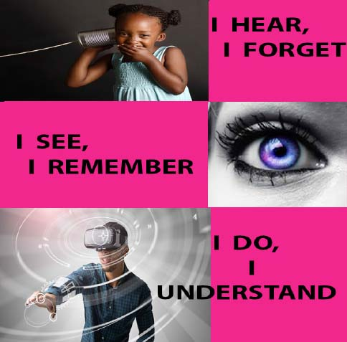
My instructional goal is simply:
To make the unknown… “KNOWN”
But if students are NOT listening, I am NOT teaching.
Felicia A. Smith
Stanford University
http://Library.Stanford.edu/People/Felicias

